Slide 1

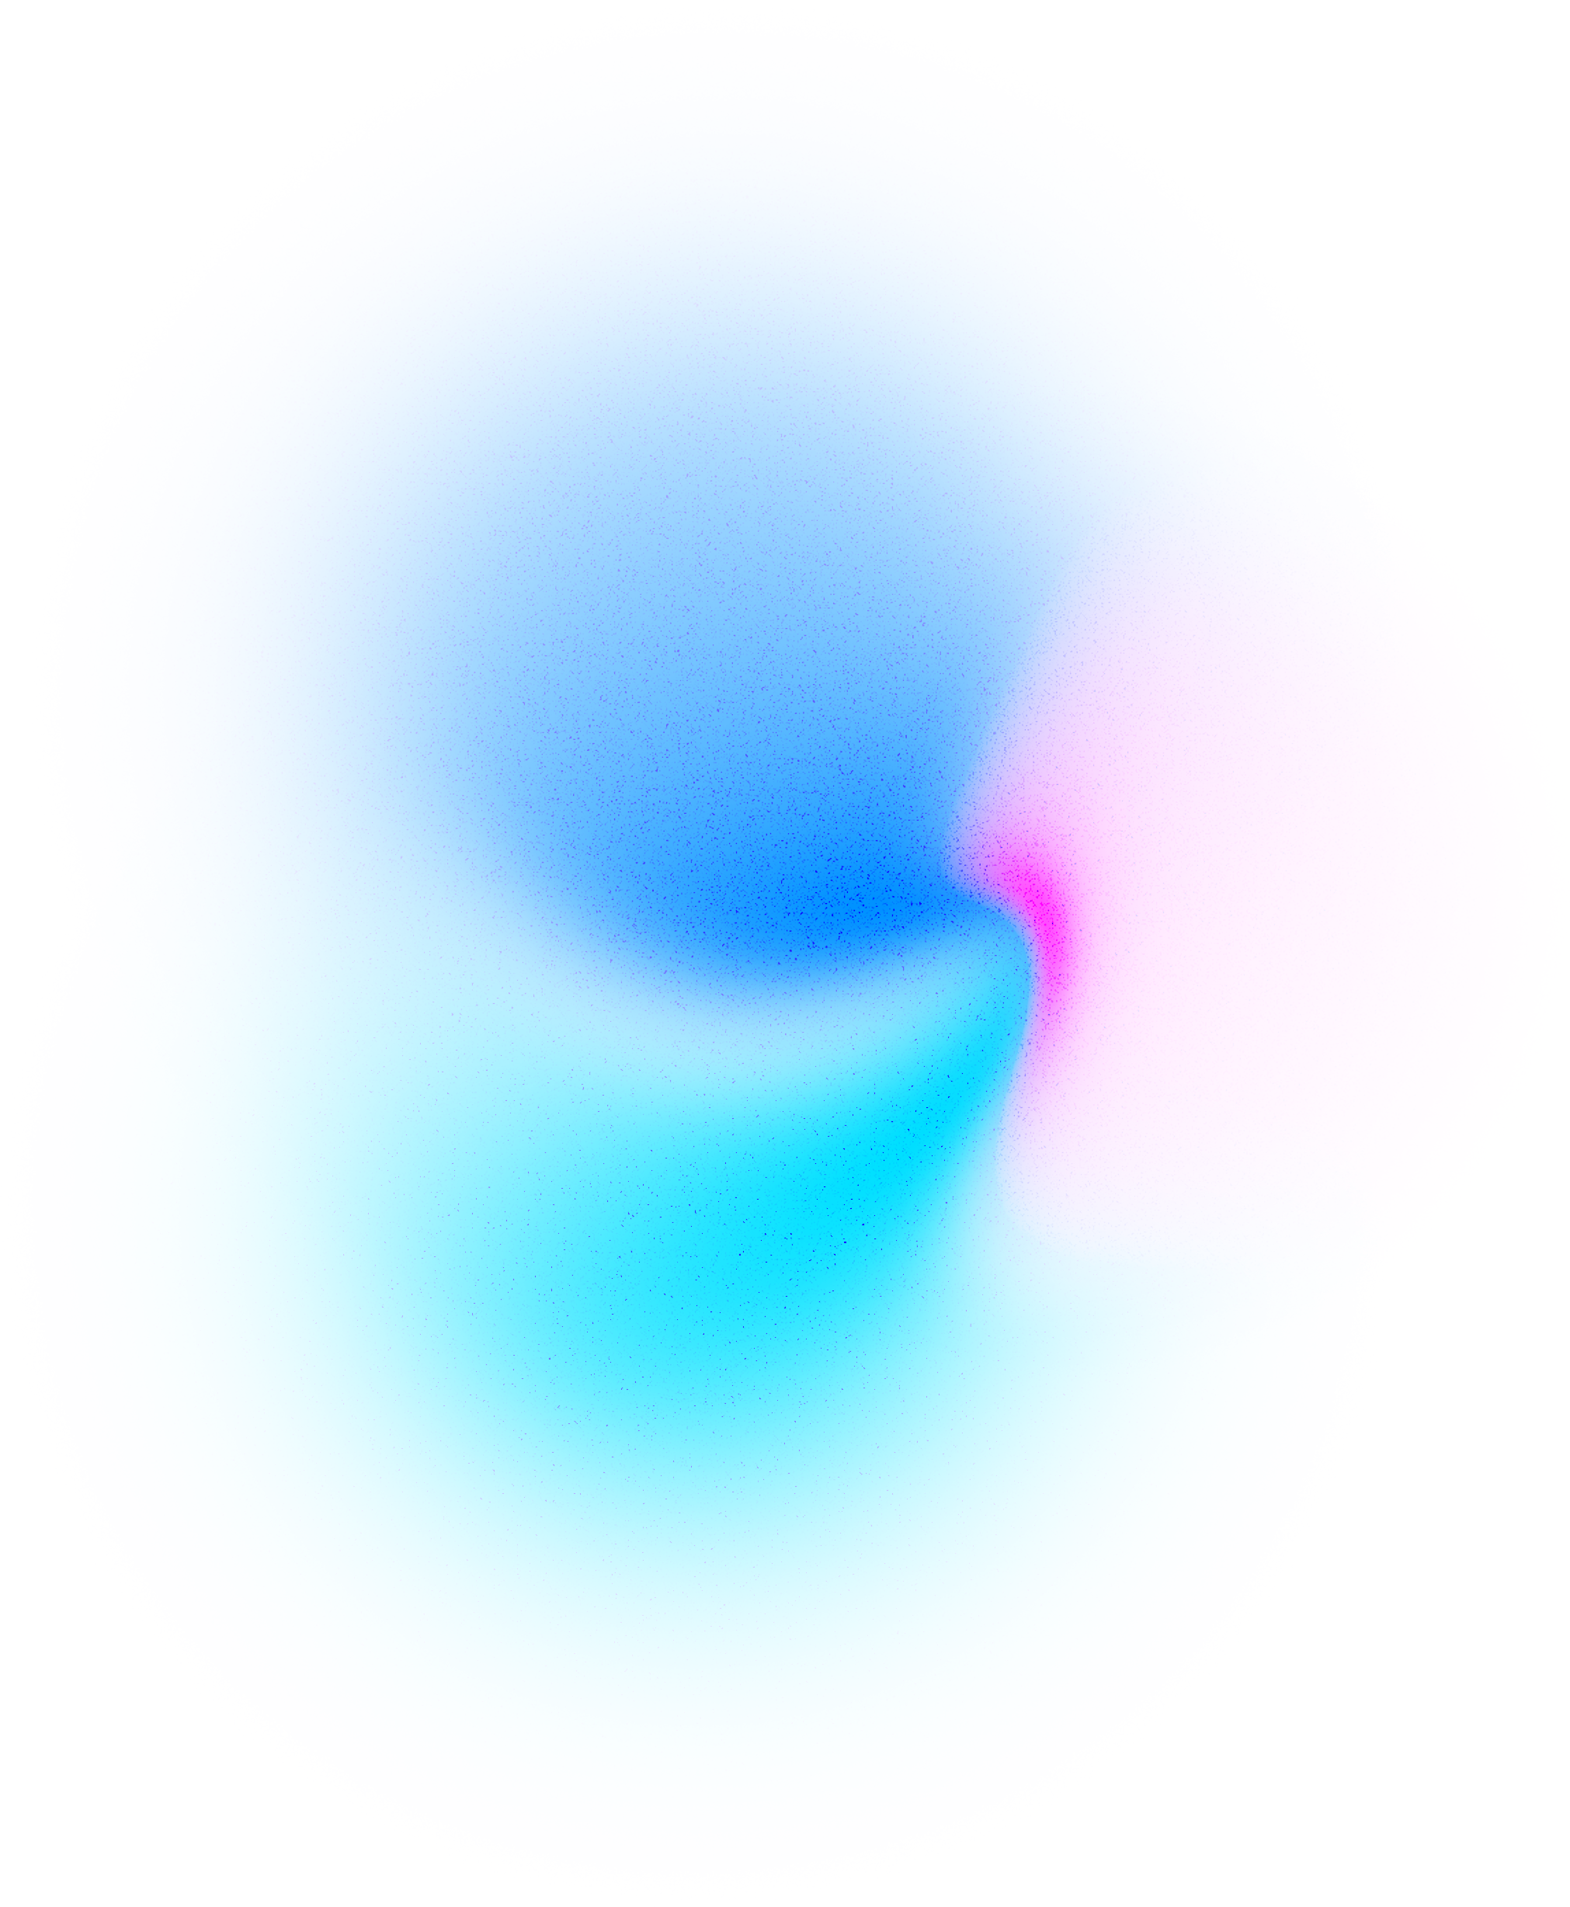
GERMAN JORDANIAN UNIVERSITY
THESIS DEFENSE
Supervisor: Dr. Samer Nofal
German Jordanian University
15.01.2025
Moodify: Leveraging Artificial Intelligence for Emotion-Based Music Recommendation and Personalized User Experience
PRESENTATION BY RAWAND SALAMEH
SCHOOL OF ELECTRICAL ENGINEERING AND INFORMATION TECHNOLOGY

Slide 2
GERMAN JORDANIAN UNIVERSITY
THESIS DEFENSE
Introduction
Bridging the Gap Between Technology and Human Emotions
Emotions are the foundation of communication, playing a vital role in human interactions and decision-making. However, analyzing emotions remains complex for both humans and machines. By leveraging advancements in emotion recognition technology, we can integrate these capabilities into user-focused applications, offering a powerful opportunity to bridge the gap between technology and emotional understanding.
PRESENTATION BY RAWAND SALAMEH
PAGE 02 - 20

Slide 3
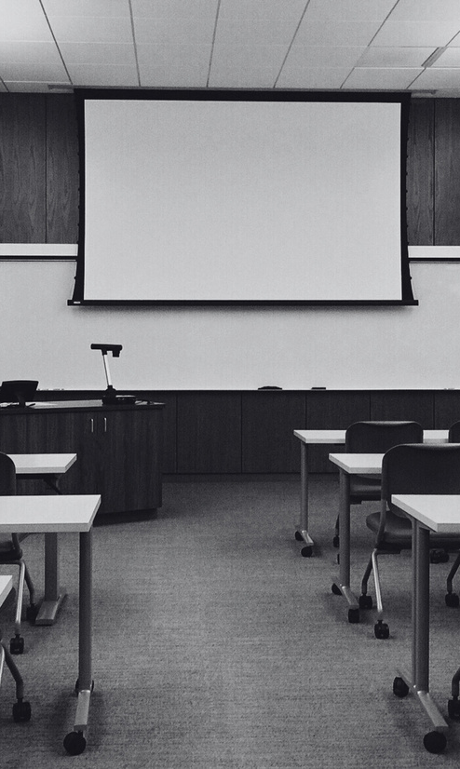
GERMAN JORDANIAN UNIVERSITY
THESIS DEFENSE
The main objective
The development of an iOS mobile application for adaptive music recommendation, achieved by predicting emotions based on mood deciphered from text, facial expression and speech(tone of voice), and recommending music recommendations tailored to the emotional state.
The goal
Closing the gap between advancements for user-focused applications and achieving user fulfillment and enjoyment
PRESENTATION BY RAWAND SALAMEH
PAGE 03 - 20

Slide 4
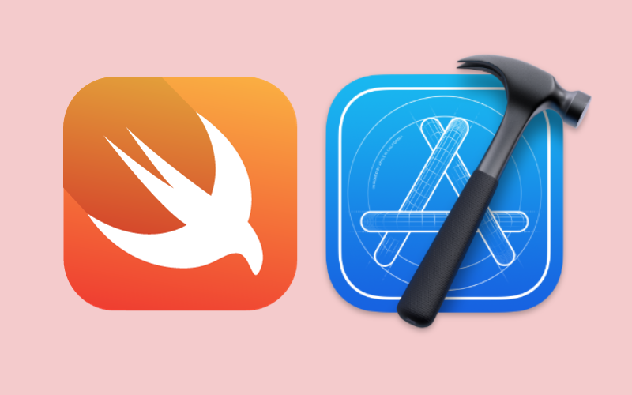
GERMAN JORDANIAN UNIVERSITY
THESIS DEFENSE
Development tools
Swift User Interface(SwiftUI):
Intuitive ways for designing user interface
Responsive layouts
Seamless intergartion with iOS features
Xcode:
All-in-one development tool for Apple platforms
Seamless integration with SwiftUI
Advanced debugging tools
PRESENTATION BY RAWAND SALAMEH
PAGE 04 - 20

Slide 5
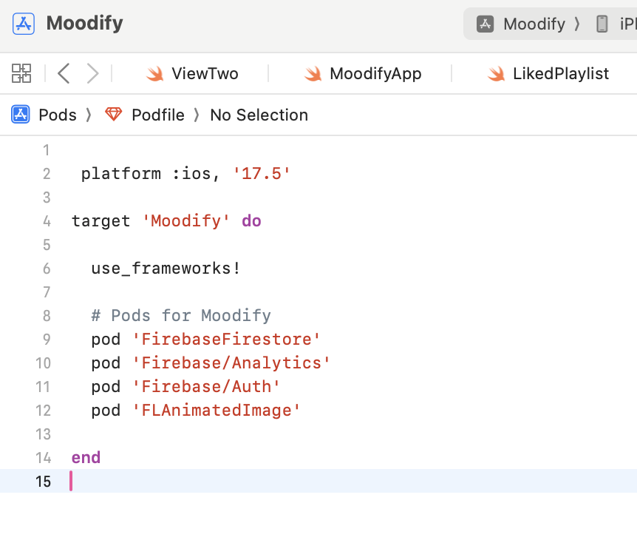
GERMAN JORDANIAN UNIVERSITY
THESIS DEFENSE
Backend services (Firebase cloud database)
Configuration of Firebase:
Create Firebase project
Link project to Moodify App
Add Firebase SDK using the Cocoapods dependency manager
1
Firebase(real-time authentication)
2
FirebaseFirestore for collections
PRESENTATION BY RAWAND SALAMEH
PAGE 05 - 20

Slide 6
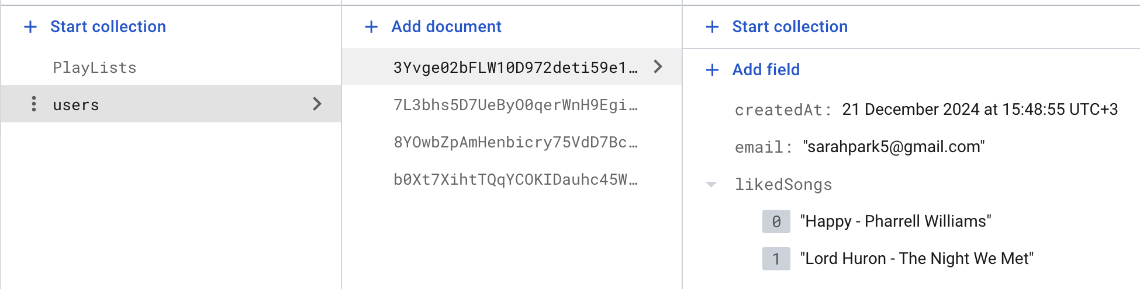
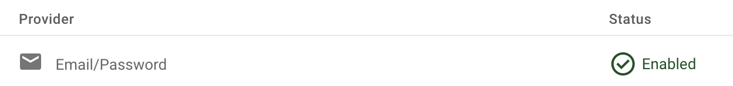
GERMAN JORDANIAN UNIVERSITY
THESIS DEFENSE
Implementations with firebase
First implementation
Second implementation
A sign in view that utilized Firebase Authetication using email/password
A signup view for creating new users with and adding them to users collection
A liked playlist view for fetching users liked songs from users collection
PRESENTATION BY RAWAND SALAMEH
PAGE 06 - 20

Slide 7
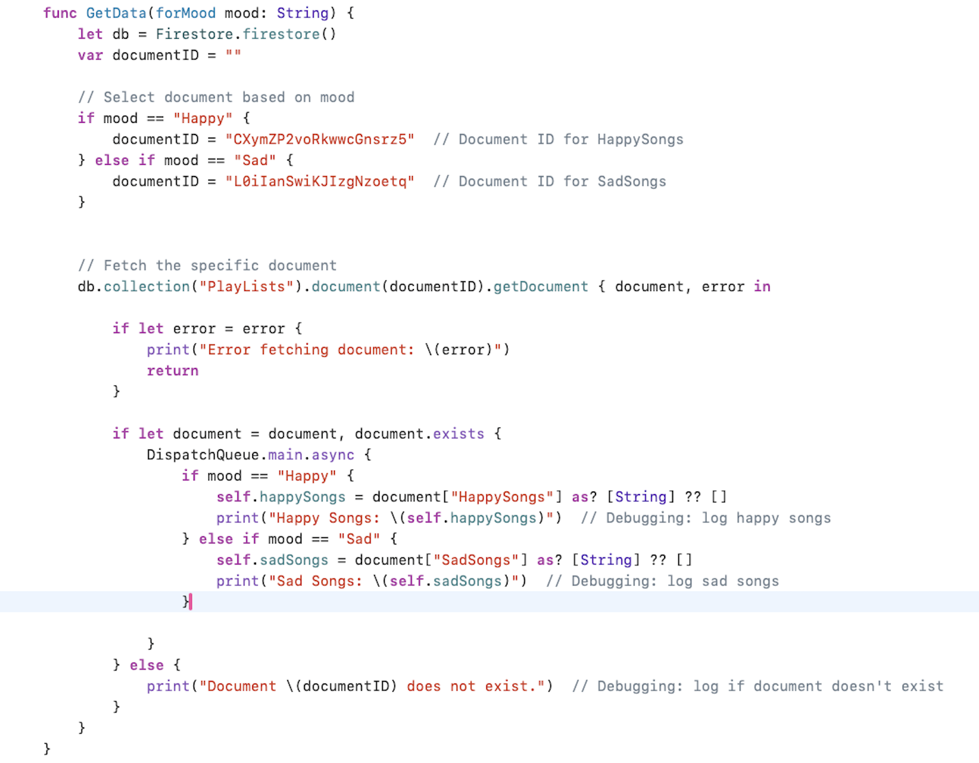
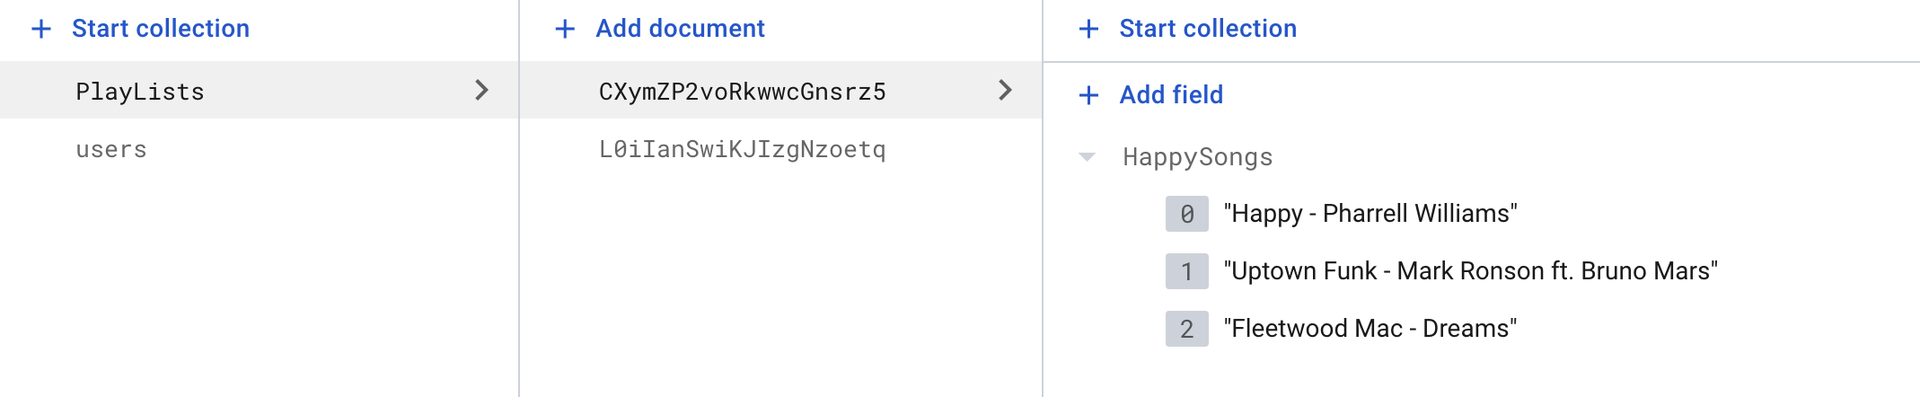
GERMAN JORDANIAN UNIVERSITY
THESIS DEFENSE
Third implementation
Music playlist views for fetching song names from the Playlist collection based on string of emotion passed to a shared (ViewModel class)
PRESENTATION BY RAWAND SALAMEH
PAGE 07 - 20

Slide 8
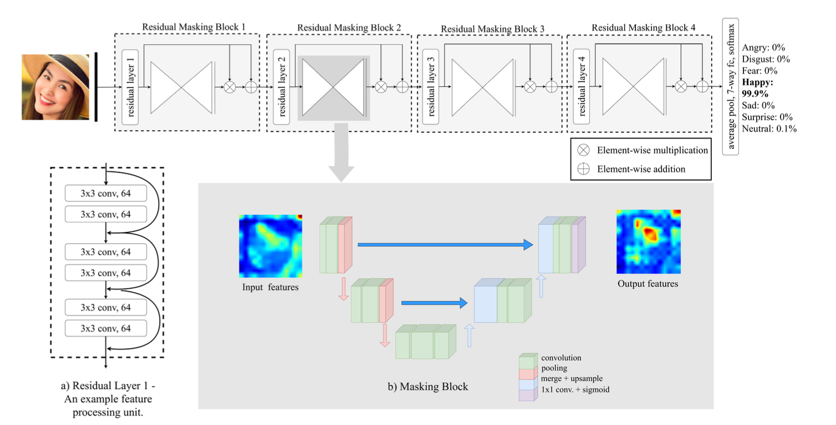
GERMAN JORDANIAN UNIVERSITY
THESIS DEFENSE
RMN Model
For facial recognition, a PyTorch Residual Masking Network(RMN) pretrained model was utilized.
RMN leverages two powerful machine learning architectures:
Deep Masking Network(residual blocks)
Masking blocks(utilizes a U-Net like architectiure)
PAGE 08 - 20
PRESENTATION RAWAND SALAMEH

Slide 9
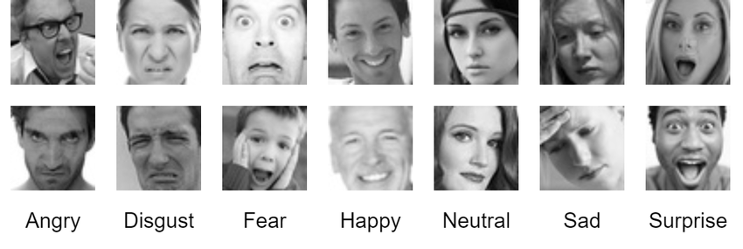
GERMAN JORDANIAN UNIVERSITY
THESIS DEFENSE
DATASET
The Dataset that was used for RMN facial recognition model was the public image dataset FER2013, which contains a total of 35887 gray-scaled images of size 48 x 48 pixels.
for this model, 28709 images were used for training, 3859 for validation, and 3589 for testing.
The different labels of images: happy, sad, surprise, disgust, neutral, anger, fear.
PRESENTATION RAWAND SALAMEH
PAGE 09 - 20

Slide 10
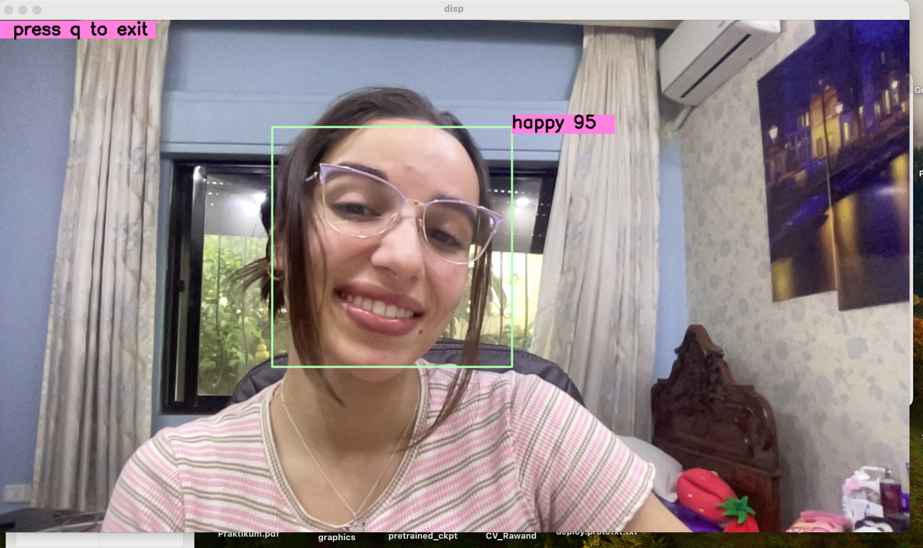
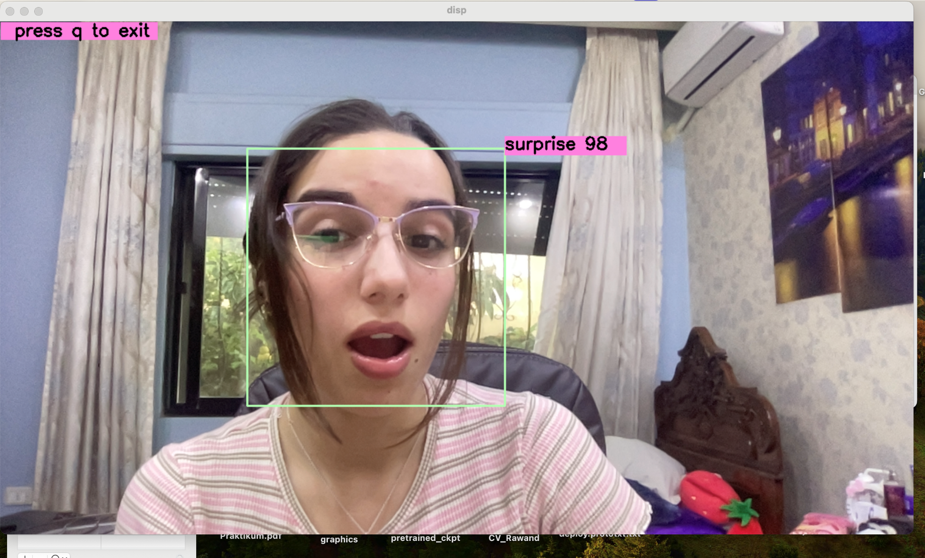
GERMAN JORDANIAN UNIVERSITY
THESIS DEFENSE
Testing the Model
The model was tested before integration through:
Passing a single image with a single frame to RMN
Testing RMN via the WebCam
PRESENTATION BY RAWAND SALAMEH
PAGE 10 - 20

Slide 11
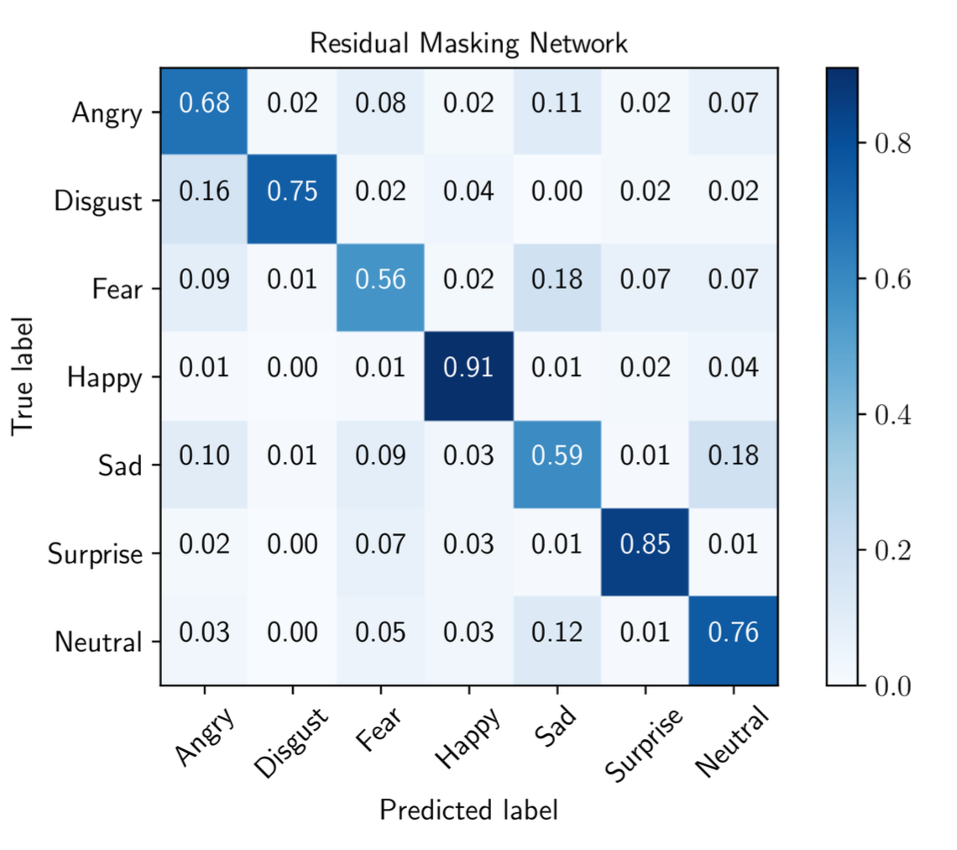
GERMAN JORDANIAN UNIVERSITY
THESIS DEFENSE
RMN Accuracy
The RMN model achieves an accuracy of 76.82% with higher accuracy with predicting Happy, Sad emotions.
PRESENTATION BY RAWAND SALAMEH
PAGE 11 - 20

Slide 12
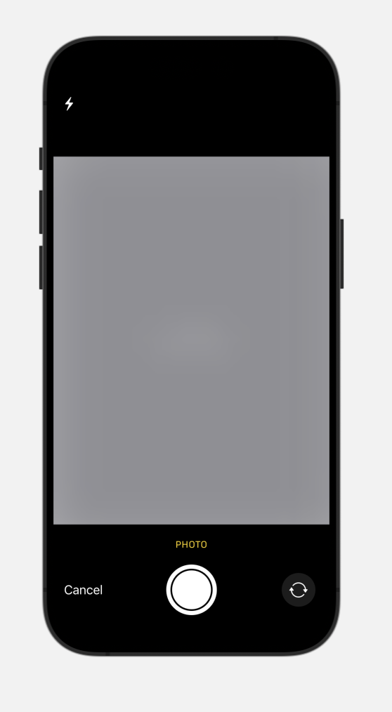
GERMAN JORDANIAN UNIVERSITY
THESIS DEFENSE
Integrating RMN to Moodify
Swift does not directly support PyTorch framework for operating with machine learning models.
CoreMl was employed and the model was converted to a (.mlformat).
A UIkit component camera view utilized the RMN model inside the app.
PRESENTATION BY RAWAND SALAMEH
PAGE 12 - 20

Slide 13
GERMAN JORDANIAN UNIVERSITY
THESIS DEFENSE
SVC Model
For voice recognition, a sckikitlearn library support vector classifier (SVC) was employed, original model structure was encapsulated within a class.
Model code was refactored making it more straighforward and direct for training.
the model utilizes 4 datasets for training:
The Ryson Audio- Visual Database of Emotional Speech and Song (RADVESS), that contains 24 actors (12 male, 12 female).
The Toronto Emotional Speech Set (TESS), a set of 200 target words were spoken in the carrier phrase “Say the word (blank)” by two actresses (aged 26 and 64 years).
The third dataset was called emotion database (EMO-DB), which contains emotional utterances spoken by actors.
The last dataset used, it is a custom training dataset that has unbalanced, noisy datasets that can be updated with new data by each user that trains an instance the model, 60 new audio files were added for training.
PRESENTATION BY RAWAND SALAMEH
PAGE 13 - 20

Slide 14
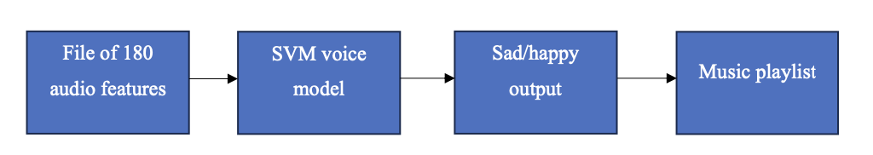
GERMAN JORDANIAN UNIVERSITY
THESIS DEFENSE
SVC Model training process:
Loads training data from data extractor module
Converts audio into (.wav) files
Extract 180 audio features(Mfcc, Chroma, Mel)
PRESENTATION BY RAWAND SALAMEH
PAGE 14 - 20

Slide 15
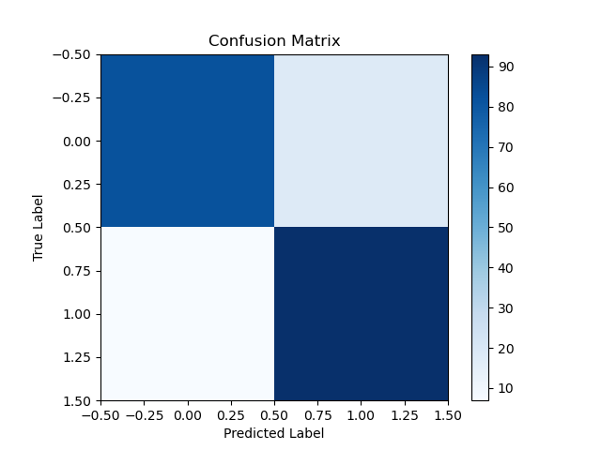
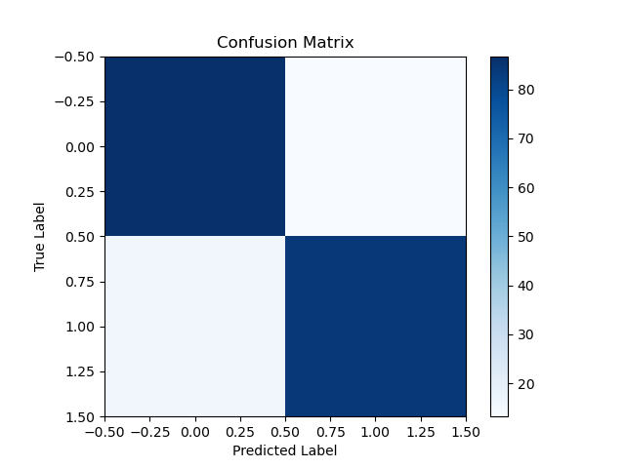
GERMAN JORDANIAN UNIVERSITY
THESIS DEFENSE
Training & Comparing Scikit-learn Models
The SVC model was compared with another scikitlearn ligistic regression(LOG) modelbefor eintegration to Moodify
Logistic regression model(LOG) accuracy: 0.87
Support Vector model(SVC) accuracy: 0.86
PRESENTATION BY RAWAND SALAMEH
PAGE 15 - 20

Slide 16
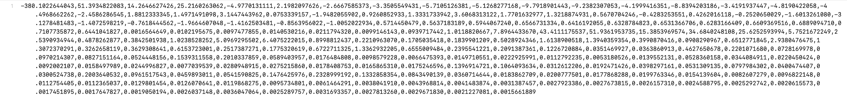
THESIS DEFENSE
GERMAN JORDANIAN UNIVERSITY
SVC Model Integration
Oroginally the model would make a user record his voice to fetch the audio and create a prediction for it, due to complication with signal processing inside of Swift UI, the models general functionality was displayed using two buttons:
First button would load a (.txt) file with 180 comma seperated happy audio features
Second button would load a (.txt) file with 180 comma seperated sad audio features
PRESENTATION BY RAWAND SALAMEH
PAGE 16 - 20

Slide 17
Youtube API for opening music video
GERMAN JORDANIAN UNIVERSITY
THESIS DEFENSE
The last feature that was used in Moodify App was the ability to expand the user experience to enjoy not just muisc audio but also the music videos using Youtube API for fetching the video id, the process:
An API key was retrieved from Google Console
watch video symbol would trigger an instance of a youtube manager class for sending an HTTP request to youtube
The response is 5 videos that are fetched with their id’s
The first video id from the videos array returned is then opened through a WebViewKit(Apple Framework)
PRESENTATION BY RAWAND SALAMEH
PAGE 17 - 20

Slide 18
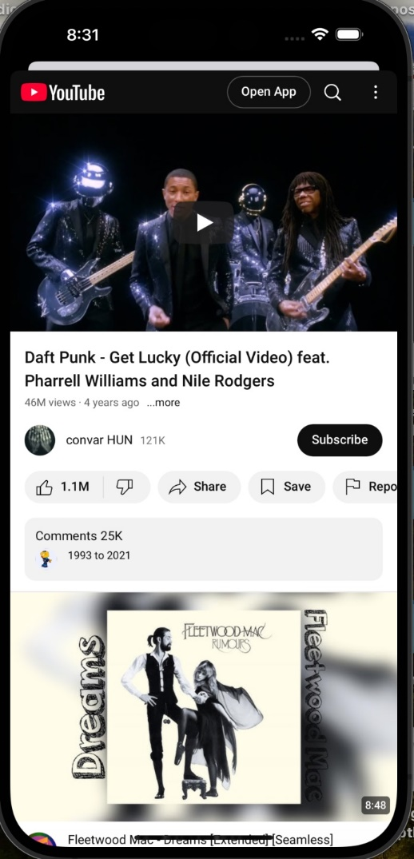
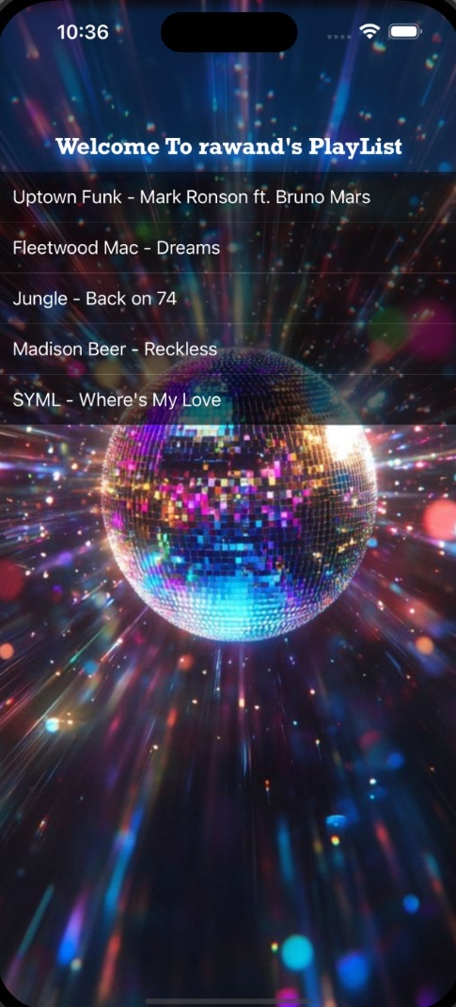
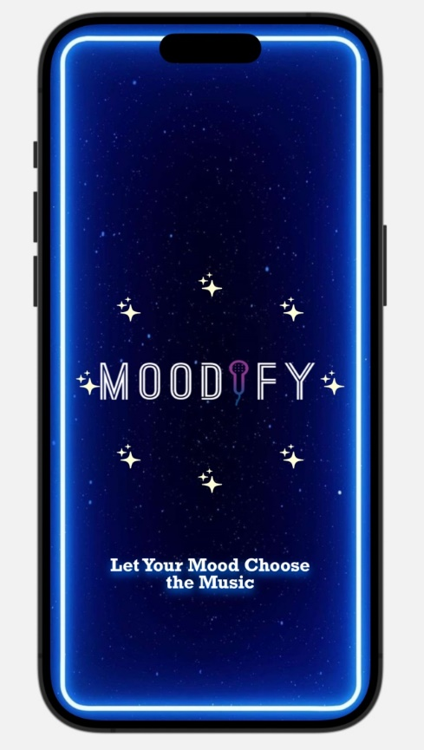
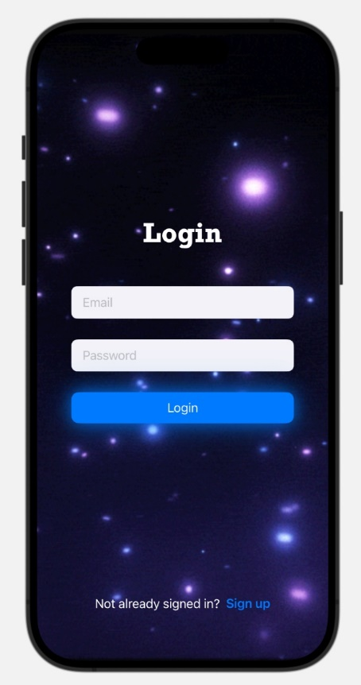
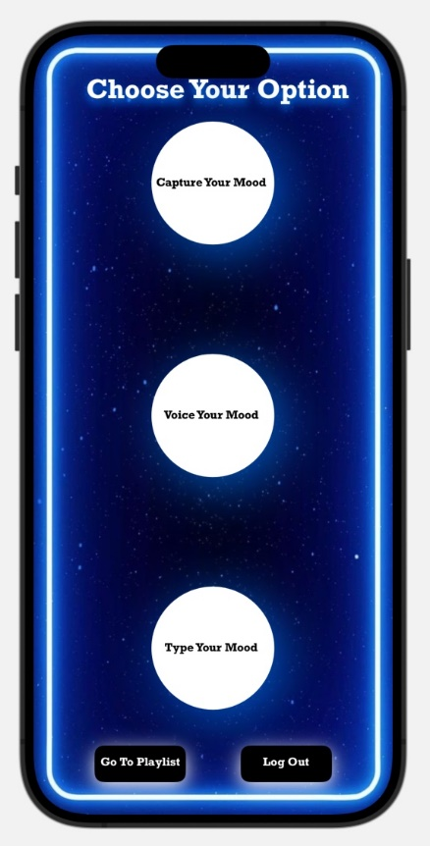
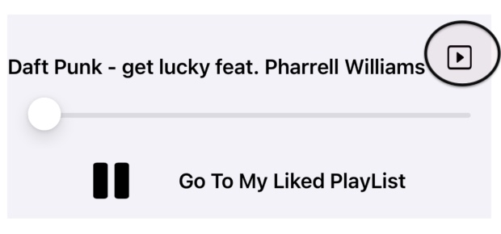
Results
GERMAN JORDANIAN UNIVERSITY
THESIS DEFENSE
PRESENTATION BY RAWAND SALAMEH
PAGE 18 - 20

Slide 19
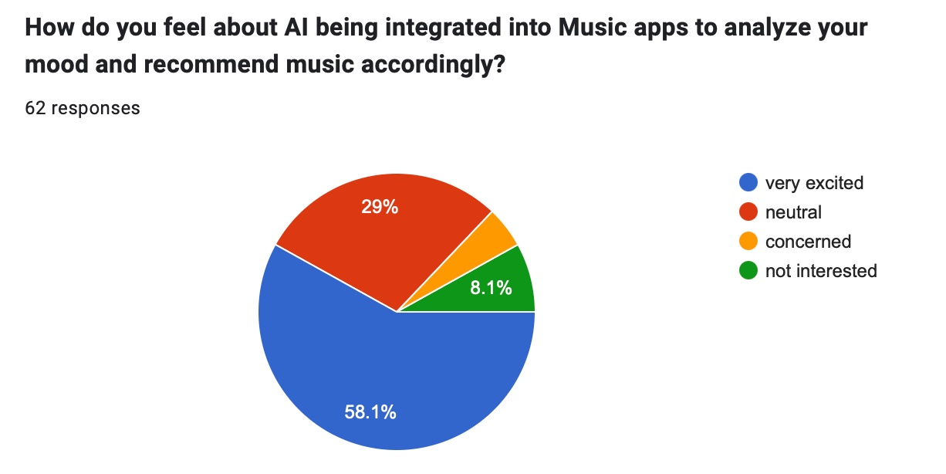
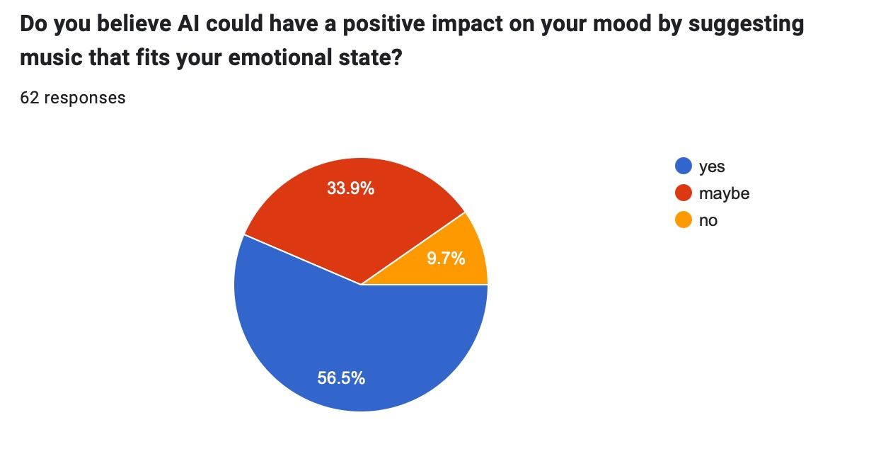
Key findings
GERMAN JORDANIAN UNIVERSITY
THESIS DEFENSE
The majority of respondents said that mood-based music recommendation apps could engage the user experience
Many highlighted the benefit of reducing the time it takes for music selection
Some respondents shared that they prefer having control over their music selection
PRESENTATION BY RAWAND SALAMEH
PAGE 19 - 20

Slide 20
Conclusion
GERMAN JORDANIAN UNIVERSITY
THESIS DEFENSE
Moodify provides a modern, engaging user experience, with features like facial and voice recognition, including real time management for users and playlist, it showcased the potential of combining emotion recognition and user-focused applications, the feedback taken validates the apps concept and the identified areas for improvement showed opportunities for future development.
PRESENTATION BY RAWAND SALAMEH
PAGE 20 - 20

Slide 21
Thank you !
GERMAN JORDANIAN UNIVERSITY
THESIS DEFENSE
PRESENTATION BY RAWAND SALAMEH
Student ID: 20211501117

